Slide 1

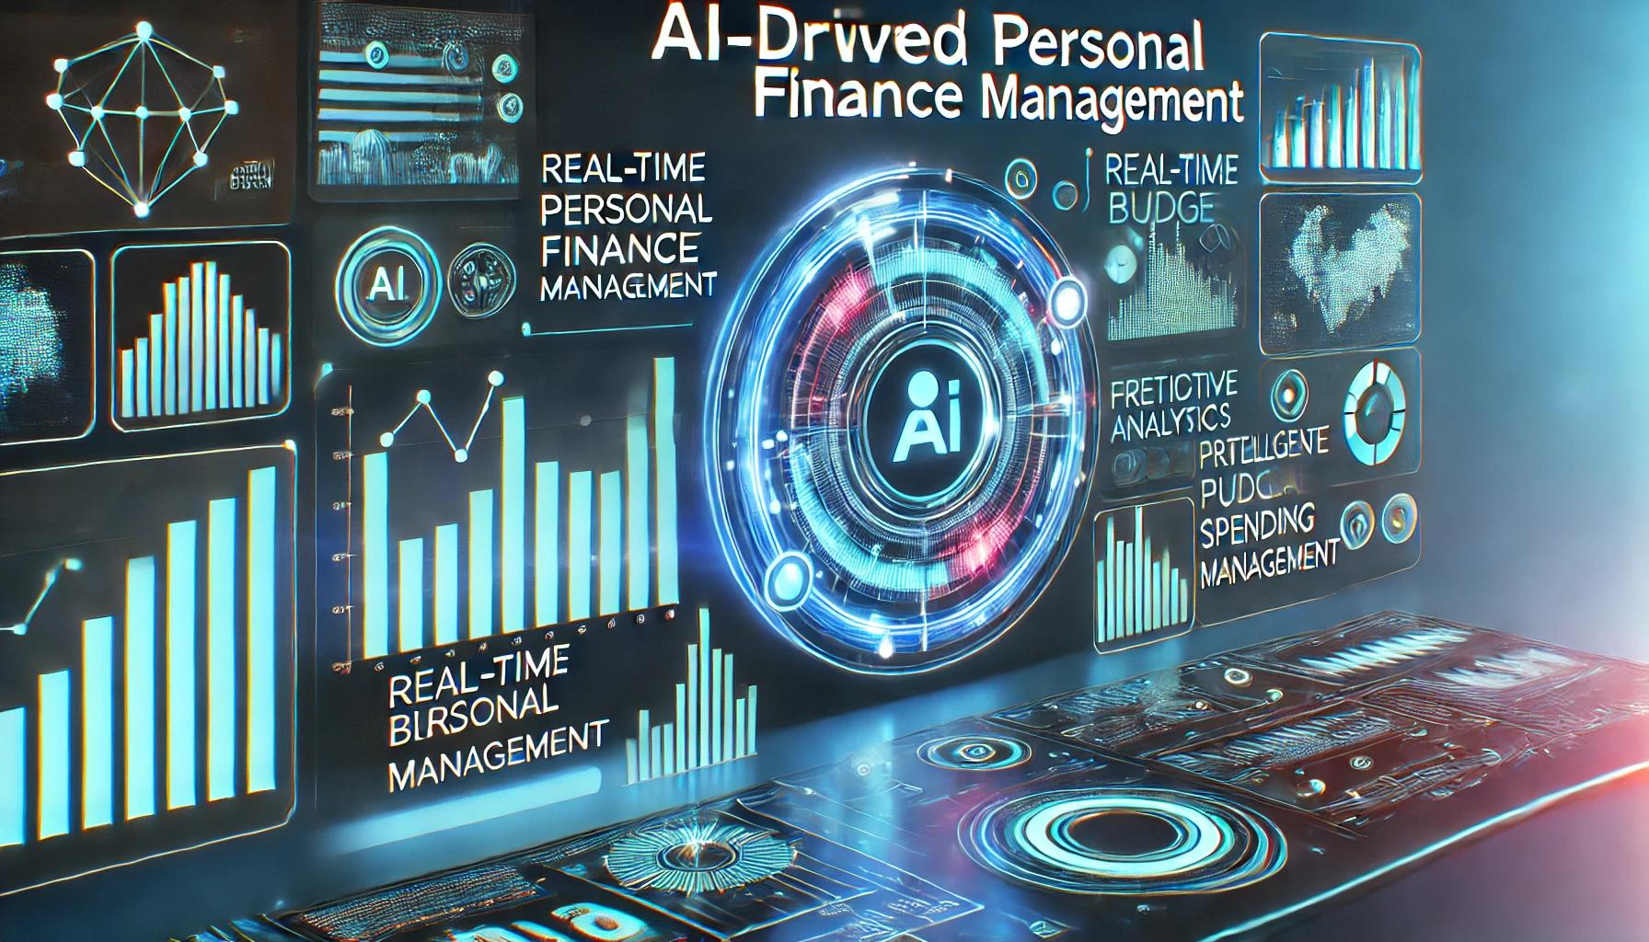
AI-Driven Personal Finance Management

Slide 2

AI-Driven Personal Finance Management
This AI-powered system automates budgeting. It tracks expenses and predicts future spending. It uses advanced machine learning models. These include LSTM and ARIMA. It transforms how individuals manage their finances. The system helps users to achieve their financial goals.
Counsellor Name:
K.Shiva Kumar
Assistant Professor
Presented By:
B.Vishnu
B22AI055
6CSM1

Slide 3
Contents:
Title
Abstract
Problem Statement
Objectives
Requirements (Hardware & Software) Technology
→ Datasets
→ platforms
Methodology
Expected outputs
Performance metric
Summary

Slide 4
Abstract: The Future of Finance
MyFinanceAI
Key Innovations
MyFinanceAI solves financial challenges. It automates real-time expense tracking using AI models. The system predicts future expenses and detects fraud. Personalized savings and investment insights are provided. Deep learning and Explainable AI make finance easier.
AI-driven real-time tracking and categorization
Predictive models (LSTM, ARIMA) for budgeting
Anomaly detection for fraud prevention
Explainable AI to ensure financial transparency

Slide 5




The Problem: Manual Finance
Manual budgeting is tedious – People struggle to track expenses.
Lack of smart financial insights – No personalized advice on saving or spending.
Fraud detection is limited – Unusual transactions often go unnoticed.

Slide 6



Tech Requirements: Hardware & Software
Hardware
High-performance computing for deep learning.
Cloud
Cloud storage for financial data.
Databases
Secure databases for transaction logs.
Software
Programming: Python (Pandas, TensorFlow, Scikit-learn). AI Models: LSTM, ARIMA, Anomaly Detection. Database: MySQL, MongoDB. Security: Blockchain. APIs: Financial data integration.

Slide 7




Data & Platforms: Building the AI
Datasets
Platforms
Public financial datasets like Budget.csv
(Kaggle datasets).
Google Colab, Jupyter Notebook – for model training.
AWS, Google Cloud – for cloud AI processing.
Synthetic banking transaction data (for fraud detection testing).
GitHub – for version control and collaboration.

Slide 8
Methodology: How MyFinanceAI Works
Data Collection
1
Aggregates bank statements and user inputs.
Preprocessing
2
Cleans and normalizes data.
Categorization
3
Uses NLP to classify expenses.
AI Models: LSTM, ARIMA will forecast future expenses.Machine learning detects unusual spending. Financial insights displayed via dashboards.
1.Data Collection 2.Data Preprocessing 3.Predictive Analysis
4.Fraud Detection 5.Dashboard Development 6.Deployment

Slide 9

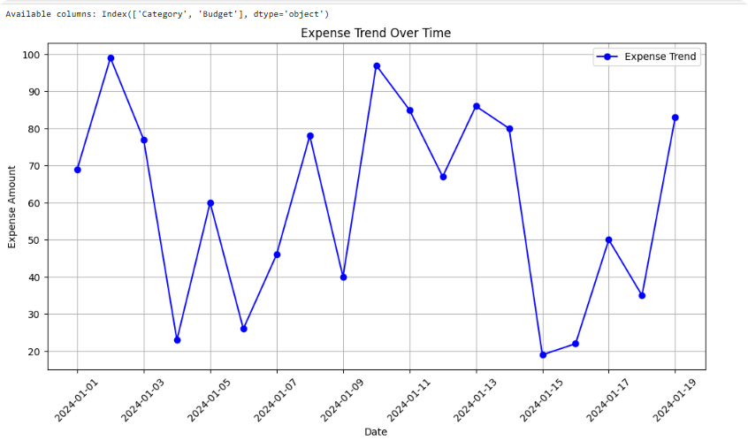
Expected Outputs: Smart Finance
Real-time Expense Tracking
Track expenses easily to avoid overspending.
Fraud Detection
Smart Bill Reminders to protect your finances.

Slide 10

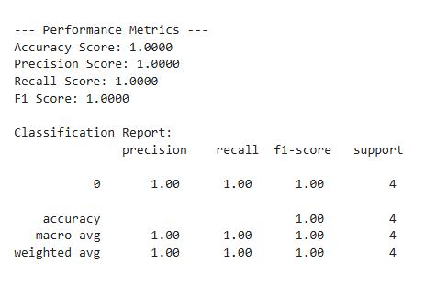
Performance Metrics: Measuring Success
95%
90%
99%
Prediction Accuracy
Categorization Precision
Fraud Detection
Measures forecasting precision of AI models.
Checks correct expense grouping.
Measures AI's fraud detection rate.

Slide 11





Summary: The Future is Smart
AI-Powered
Simplifies financial management.
Deep Learning
2
Predictive budgeting & fraud detection.
Real-time Insights
Offers financial insights.
MyFinanceAI integrates AI with finance. It makes budgeting smarter and efficient. It ensures security and transparency with Explainable AI.

Slide 12
References:
[1] CareerBuilder, "Living Paycheck to Paycheck is a Way of Life for Majority of U.S. Workers, According to New CareerBuilder Survey," CareerBuilder Press Room, Aug. 2017. [Online]. Available: https://press.careerbuilder.com/2017-08-24-Living Paycheck-to-Paycheck-is-a-Way-of-Life-for-Majority-of-U-S-Workers-According-to-New-CareerBuilder-Survey
[2] C. R. Berger, "Personal Finance Statistics," Zippia, Jan. 2023. [Online]. Available: https://www.zippia.com/advice/personal finance-statistics/
[3] J. Schmoll, "How Many Bank Accounts Should I Have?" The Balance, May 2022. [Online]. Available: https://www.thebalancemoney.com/how-many-bank-accounts-should-i-have-4589608

Slide 13

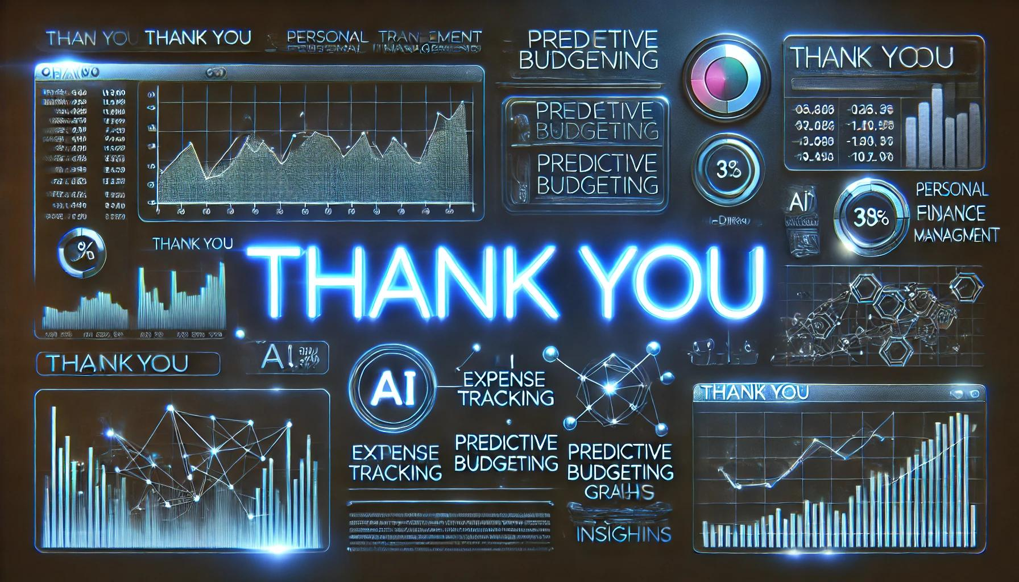
THANK YOU…

